Slide 1
DIGISIM ROUND 1 SOLUTION
TEAM NAME :- chip_burners
Aman Shreshtha
Deepak Maurya

Slide 2
State Table
present state | input |  | next state
 | left hand | right hand |  | R | L | F
0 0 | 0 | 0 | 0 0 | 0 | 0 | 1
0 0 | 0 | 1 | 0 1 | 0 | 1 | 0
0 0 | 1 | 0 | 0 1 | 0 | 1 | 0
0 0 | 1 | 1 | 0 1 | 0 | 1 | 0
0 1 | 0 | 0 | 1 0 | 1 | 0 | 1
0 1 | 0 | 1 | 0 1 | 0 | 1 | 0
0 1 | 1 | 0 | 0 1 | 0 | 1 | 0
0 1 | 1 | 1 | 0 1 | 0 | 1 | 0
1 0 | 0 | 0 | 1 0 | 1 | 0 | 1
1 0 | 1 | 0 | 1 0 | 1 | 0 | 1
1 0 | 0 | 1 | 1 1 | 0 | 1 | 1
1 0 | 1 | 1 | 1 1 | 0 | 1 | 1
1 1 | 0 | 0 | 1 0 | 1 | 0 | 1
1 1 | 0 | 1 | 1 1 | 0 | 1 | 1
1 1 | 1 | 1 | 0 1 | 0 | 1 | 0
1 1 | 1 | 0 | 0 1 | 0 | 1 | 0

Slide 3
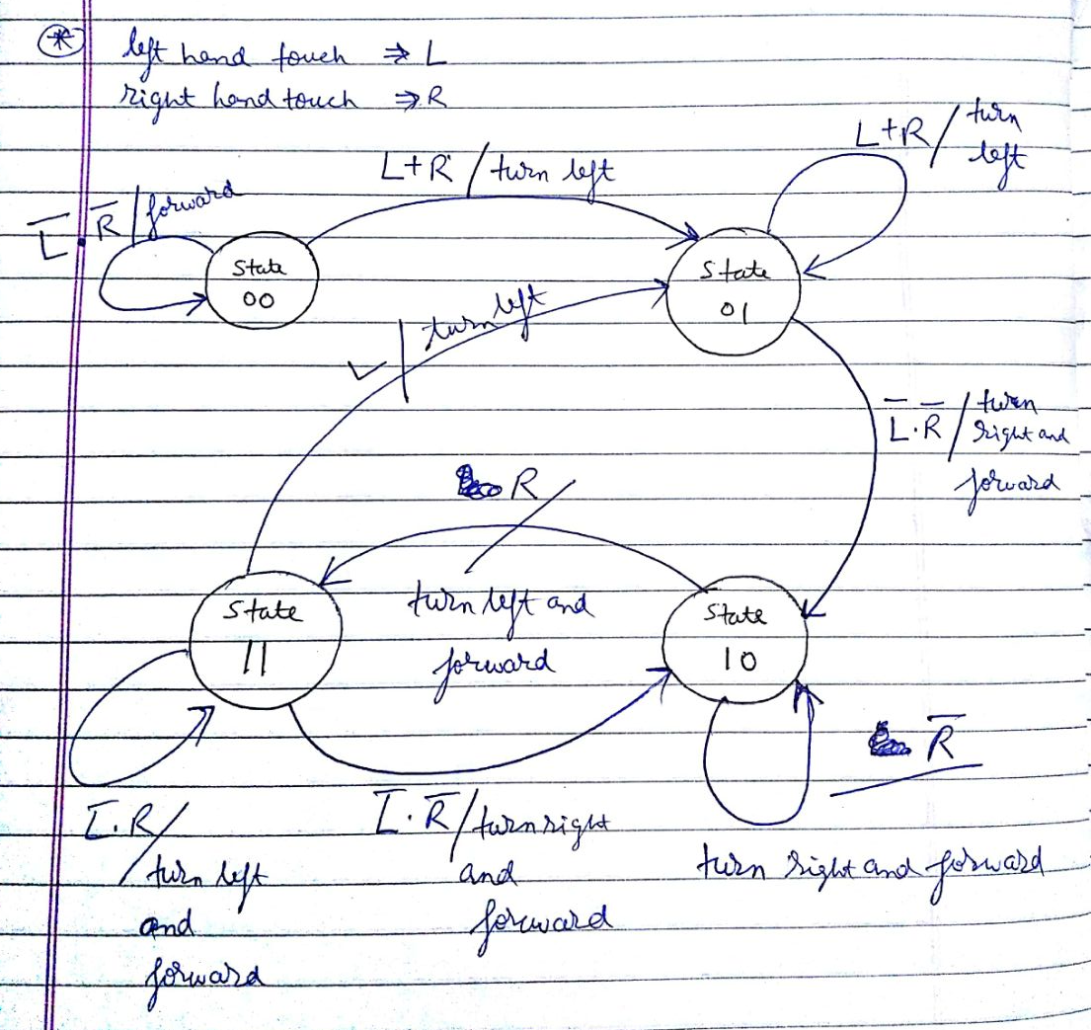
STATE DIAGRAM

Slide 4
LOGIC Behind the working of the FSM
State 00
initial state (when the robot starts the maze traversal task)
State 01
something touched (when the robot touches some obstacle for first time, either left hand touch or right hand touch or both)
State 10
wall on right (this state is reached when the robot knows that there is wall on its right and now the robot will follow that wall)
Sate 11
- move left from right wall (the bot will move a bit away from the right wall and will also move forward)

Slide 5
Initially the robot does not know anything about the maze. This state of the robot is state 00. In this state the robot will just keep on moving forward until the robot gets 1 input on the right hand or the left hand.
Once the robot touches anything , either right hand or left hand or both, it goes into the next state 01. In this state the robot knows that it has touches something and now it has to orient itself so as to now follow the right wall.
In the state 01, the robot will start rotating left until neither of its hands are touching. Now the robot knows that there is a wall on its immediate right and now the robot will follow this wall. Once the robot gets 0 , 0 input on its two hands, it will go to state 10.
In the state 10 , the robot will rotate towards right and also move forward. I have considered that the robot moves forward only a little and always turns by only 10 degrees(but the exact value of angle does not matter). So, when the robot starts rotating right and moving forward, it will eventually touch the right wall.

Slide 6
When the robot touches the right wall, i.e. when it gets 1 at right hand input , the robot will go into the next state 11. In the state 11, the robot will rotate left and move forward until the right input becomes 0.
When the right input becomes 0 , the robot again comes in state 10 and rotates right and moves forward. In this way by transition between states 10 and 11, the robot moves toward right wall and then moves away from it, and also moving forward in the process.
When the robot is in state 11 and if the left hand becomes 1 , then the robot will go to the state 01 and will again repeat the process. This will happen if the robot hits a wall in the front while moving forward.

Slide 7
THANK YOU !!

